Slide 1


Advanced potential field data inversion
Dom Fournier
Official trailer
Link to GoogleSlides
Thesis Defence
August 27, 2019

Slide 2
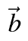
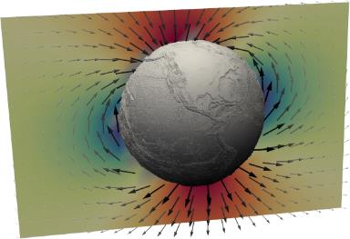
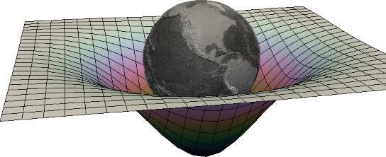
Background
Simple physics of potential fields
Gravity:
Magnetism:
geo・physics
Notes:
Friends in the audience don’t know too much about technical aspects of geophysics, but certainly know something about geophysics.
Start with the obvious - We all know that the Earth has a mass and known about its gravitational field.
And probably know about the magnetic field (aurora borealis)
Let’s get closer to see more interesting stuff

Slide 3
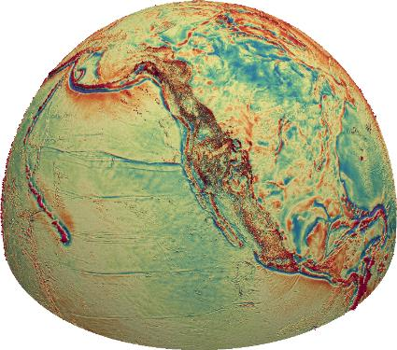
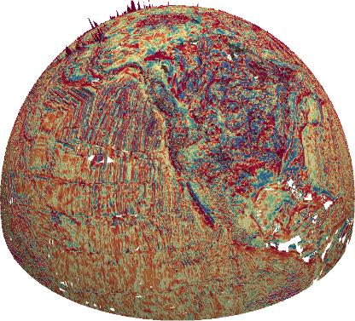
Background
Large amount of quality data
Gravity
Magnetism
UBC
20,000 km
Notes:
At 20,000 km orbit
Large quantity of data. Know a lot about the history of our planet from these datasets
Left
WGM2012 FreeAir 2-second resolution - Levelled at 10 km
Bureau Gravimétrique International (BGI) + UNESCO + IUGG
Right
EMAG2 TMI 1-second resolution - Levelled at 2 km
NOAA
Striping of mag indicator of plate tectonics
Thanks to Bane Sullivan (pyvista) for dev the viewing library

Slide 4
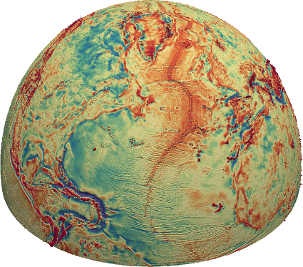
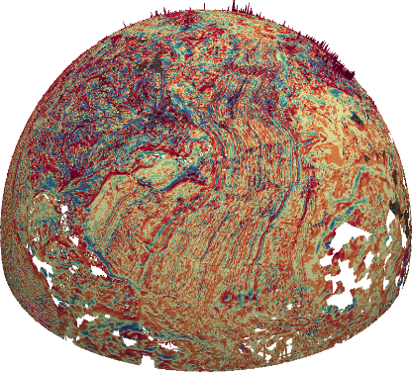
Background
Large amount of quality data
Gravity
Magnetism
20,000 km
Notes:
Quebec - where it all started for me.
More interesting features (East coast, mid-ocean ridge, Greenland)
Same view, different data

Slide 5
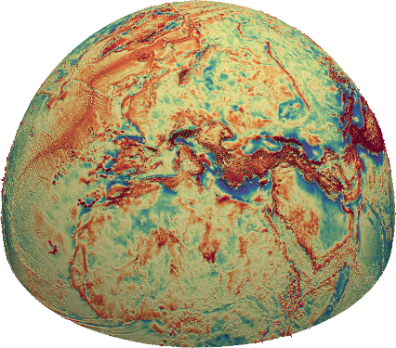
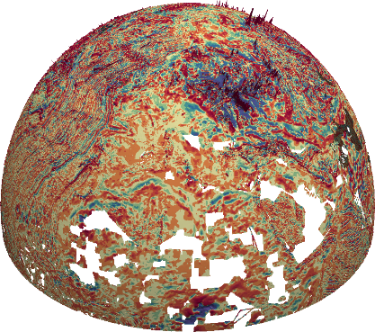
Background
Large amount of quality data - at all scales
Gravity
Magnetism
Finland
20,000 km
Notes:
Over Europe.
Strong mag fields (probably cultural)

Slide 6
Background
Large amount of quality data
Gravity
Magnetism
Finland
20,000 km
Notes:
Quebec - where it all started for me.
More interesting features (East coast, mid-ocean ridge, Greenland)
Same view, different data

Slide 7
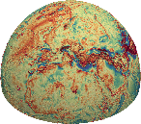
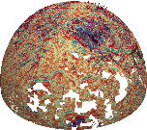
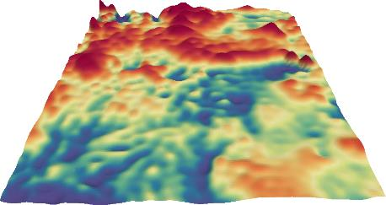
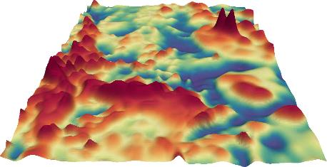
Background
Large amount of quality data - at all scales
Gravity
Magnetism
550 km
Notes:
Closer look at the data
~ 500 km (ISS orbital height)

Slide 8


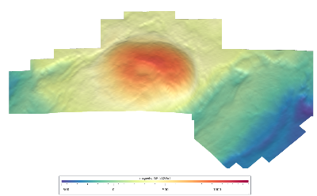
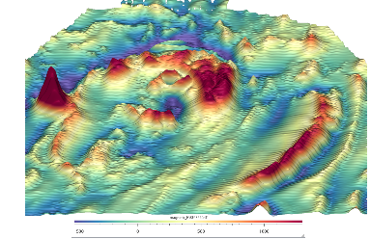
Background
Down to deposit scale - Kevitsa, Finland
Gravity
Magnetism
13 km
Notes:
Further down at the deposit scale, airborne and ground surveys
Roughly the distance between UBC to science world
25 m resolution

Slide 9
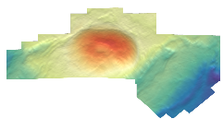
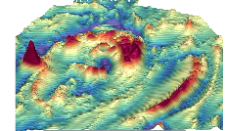
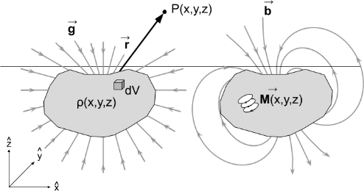
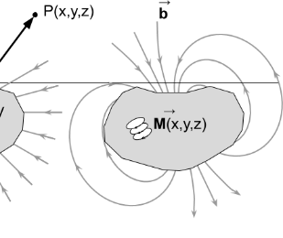
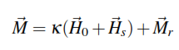
Background
Reflects changes in density and magnetization:
gz
Total magnetic intensity (TMI)
Notes:
More than just pretty colors, also gives us an idea about crustal structures
Denser bodies increase the local fields
Magnetic minerals generate secondary fields
Induced vs remanence

Slide 10
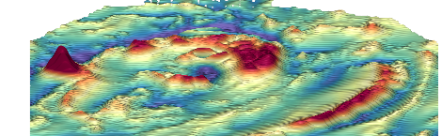
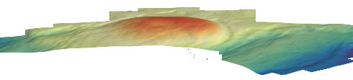
Background
Used primarily as a geological mapper
ρ2
ρ1
M
Notes:
Usual (most common) strategy is to analyze the data in 2D. Identify trends, domains.
Very useful to map geology under cover
Not the whole story though, because we are seeing a 3D response. Hard to interpret dips, overlapping signal + remanence

Slide 11
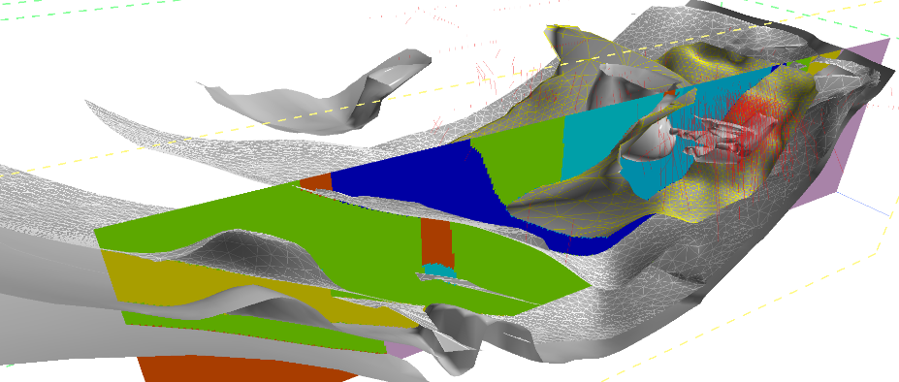
Background
Traditional approach to mineral exploration
Targeting + drilling ($$)
Modeling (Hard)
Notes:
Then geophysics is mostly pushed aside, focus on ground truth (surface, drills) to build a geological model. Costly, difficult and hard to justify every assumptions.
Hard to model because sparse information, need to extrapolate knowledge
Rarely tested back against the geophysics.

Slide 12
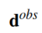
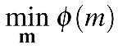
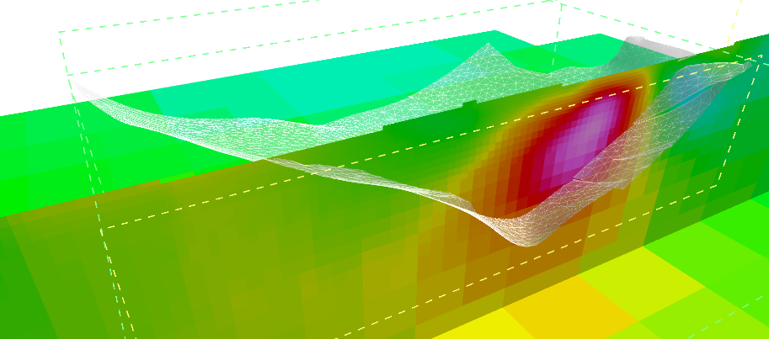
Background
Geophysical inversion
Physical property model (m)
Smooth assumptions
Notes:
New path (past 30 years) is to use 3D inversion to model physical properties
Get a general idea of the depth and shape of the instrusion

Slide 13
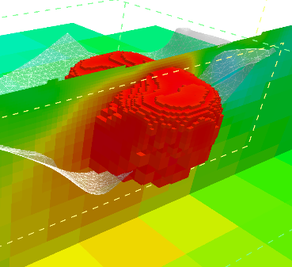
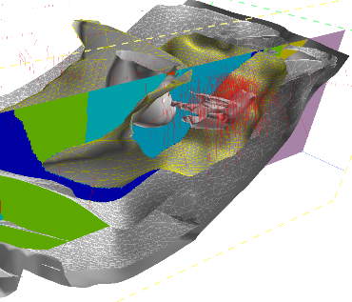
Motivation
Knowledge gap
Solution is non-unique (random noise, poor sampling)
Difficult to interpret & integrate in a geological context
?
Notes:
Major disconnect between the geologist and geophysicist
Smooth model is only one of many possible solutions
Doesn’t represent the geometry of the problem very well
Still not fully accepted by industry

Slide 14
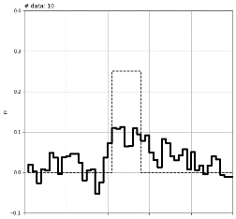
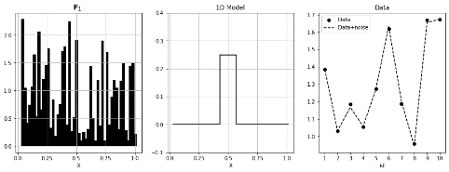
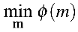
Research question
How to improve the model?
Conventional l2-norm
Notes:
Before diving into the what was done in the thesis and how I did:
First need to explain why
Here is a simpler example that show a poor recovery
1D model
Random kernels
Smooth assumptions

Slide 15
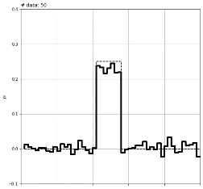
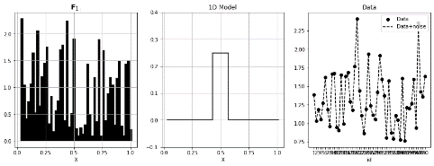
Research question
How to improve the model?
Option 1: Increase the sampling x5
#data = 50
Notes:
We could increase the amount of data
Even in the presence of noise, if we over-sample the model we could eventually get something near the true - regardless of the chosen assumptions

Slide 16
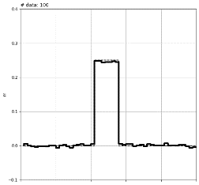
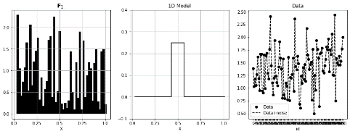
Research question
How to improve the model?
Option 1: Increase the sampling x10
#data = 100
Notes:
This includes
better hardware (EM, seismic methods)
Sample the Earth from different places
Joint inversion
For PF this is not really an option (0 frequency, always from the top)

Slide 17
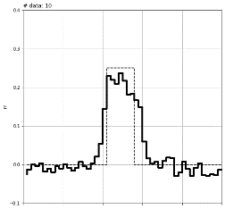
Research question
How to improve the model?
Option 2: Constrained inversions
Reference values
Notes:
Constrain the model with physical properties
Lots of research already published on the subject
Still need to drill + build a reference model (expensive, user-driven)

Slide 18
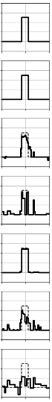
The Thesis
Extracting dominant features supported by the data:
Proposed: Sample the model space
Notes:
I am proposing to simply extract dominant patterns from the model space using a suite of potential candidates
Idea comes from the climate prediction models: already generating families of models based on common features (
all physically realistic, not random
All fit the data (globally), but not necessarily locally
We want to be driven mainly by the data

Slide 19
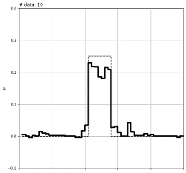
The Thesis
Extracting dominant features supported by the data:
Proposed: Sample the model space
Identify patterns
Learn
Learned model
Notes:
I am proposing to simply extract dominant patterns from the model space using a suite of potential candidates
Idea comes from the climate prediction models: already generating families of models based on common features (
all physically realistic, not random
All fit the data (globally), but not necessarily locally
We want to be driven mainly by the data

Slide 20
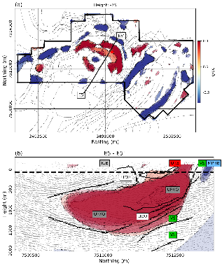
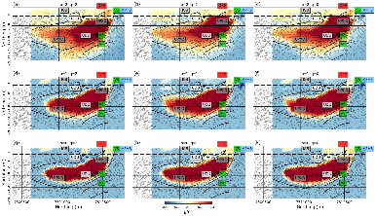
Research Objectives
Bridge the gap between geological and geophysical modeling with a flexible inversion methodology.
Generate diverse solutions (geologically meaningful)
Solve efficiently linear and nonlinear problems
Automate the learning
!
Notes:
Main goals of this research is to increase the confidence in geophysical inversion and tackle the concept of non-uniqueness.
Need to be able to
Get a suite of solutions with broad range of characteristics
Need this solutions to be geologically realistic (sharp oriented edges)
Need to solve efficiently both linear and non-linear problems
Need a path towards learning from the model space

Slide 21
Thesis arrangement
Efficient forward modeling (Chapter 2)
Lp-norm regularization (Chapter 3)
Magnetic Vector Inversion in spherical coordinates (Chapter 4)
Rotated sparse norms (Chapter 5)
Learning algorithms (Chapter 6)
Case Study (Chapter 7)
Notes:
Rest of presentation gives and overview on the technical aspects of the thesis.
Chapters build on each other.
A series on technical improvements & innovations to achieve the modeling goals.
Going to give a brief overview of each

Slide 22
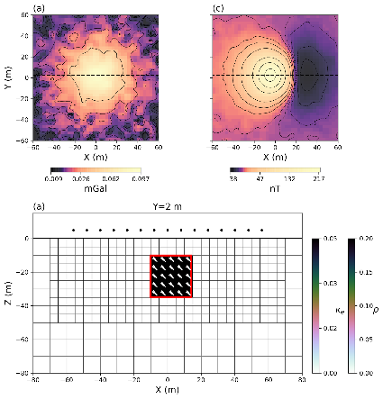
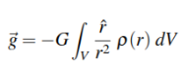
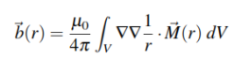
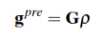
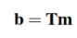
Efficient forward modeling (Ch. 2)
Dealing with large dense matrices
Gravity
Magnetism
#cells
d1
d2
d3
d4
Notes:
Chapter 2 sets up the numerical foundation to compute gravity and magnetic field on a discretized grid.
The conversion from continuous to discrete space is well-known and ends up being simple linear relationships involving dense matrices.
The more data you have and the larger the earth model is, the bigger the memory footprint.
So I spent a fair amount of work trying to make the problem more efficient.
Not scientifically interesting, but technically important.

Slide 23
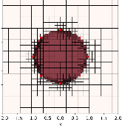
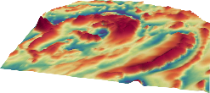
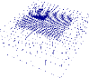
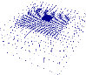
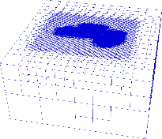


Efficient forward modeling (Ch. 2)
Dealing with large dense matrices
Mesh Decoupling
Haber and Schwartzbach (2014)
F1
Tiled forward
F2
...
...
#cells
d1
d2
FN
d3
d4
Notes:
The first way to reduce the size of the problem is to have more efficient meshes.
Written functions to break the octree mesh in the most efficient matter while preserving continuity
Second way is to split the global problem into sub-problems.
Use the nested meshes approach of Haber and Schwartback
Analogous to the footprint approach of Cox et al.

Slide 24


Efficient forward modeling (Ch. 2)
Dealing with large dense matrices
Mesh Decoupling
Linear algebra, in parallel
Haber and Schwartzbach (2014)
F [ m ] = b
SSD Chunks
F1
Tiled forward
F2
...
...
#cells
d1
d2
FN
d3
d4
Notes:
Third way is to store the tiled matrices out of RAM on SSD
The new open-source library Dask allows to store on disk and access in parallel on Zarr file format
This is really promising considering the increased comm speed on latest SSD tech. Can be expanded to EM problems as well.

Slide 25
Thesis arrangement
Efficient forward modeling (Chapter 2)
Lp-norm regularization (Chapter 3)
Magnetic Vector Inversion in spherical coordinates (Chapter 4)
Rotated sparse norms (Chapter 5)
Learning algorithms (Chapter 6)
Case Study (Chapter 7)
Notes:
Chapter 3: Focusses on the inversion part.
Builds upon my MSc.(2015)

Slide 26




Mixed lp-norm regularization (Ch. 3)
Solving the inverse problem:
Five competing objectives:
Data misfit
Regularization
Notes:
Main idea is that the conventional smooth inversion are not quite giving the interesting result.
Instead of using the l2-norm, we can use other assumptions for small, or compact bodies

Slide 27

Mixed lp-norm regularization (Ch. 3)
Conventional l2-norm
Solving the inverse problem:
Five competing objectives:
Data misfit
Regularization
Notes:
Main idea is that the conventional smooth inversion are not quite giving the interesting result.
Instead of using the l2-norm, we can use other assumptions for small, or compact bodies

Slide 28






Mixed lp-norm regularization (Ch. 3)
Lawson Regularization
Benefits of sparse norms
≈
true
sparse
blocky
both
smooth
Notes:
Some elaboration about how the different norms give a different output
Lawson norm
Difficulties with convergence for p<1

Slide 29





Mixed lp-norm regularization (Ch. 3)
l2-norm
Solving the inverse problem:
Regularization
l1-norm
l0-norm

Slide 30



Mixed lp-norm regularization (Ch. 3)
Scaling issues !
Mixing the norms
Notes:
Issues arise when we try to combine different norms within the same objective function.
Can look at the gradients of the function to explain this.
Clearly p and epsilon drive the solution.

Slide 31



Mixed lp-norm regularization (Ch. 3)
Solution: Scaled gradients
Mixing the norms
γ
Notes:
Each sub-problems are minimized, moving towards a steady state that has the right character.
Put more emphasis on keeping the impact of each functions equal, rather than focussing on the actual minimization of a norm.
Outline the initial problem of minimizing a specific function: untimely want to scale things to keep alll components at play.
Mention something about minimizing the original function.

Slide 32

Mixed lp-norm regularization (Ch. 3)
Mixing the norms
Notes:
We don’t know ahead of time what alpha values will be needed to get equal contribution
So we take steps and correct the scaling along the way
At the end, when epsilon -> 0, we reach a steady state. Each sub-problems as solve to their minimum
Turns out that if we maintain good balance, than we end up at lower phi, likely because all functions are being minimized and not trapped in a local

Slide 33

Mixed lp-norm regularization (Ch. 3)
Scaling the gradients
Mixing the norms
Regularization
Gradients
Notes:
Some elaboration about how the different norms give a different output
Lawson nomr
Difficulties with convergence for p<1
Prepare slides for questions

Slide 34


Mixed lp-norm regularization (Ch. 3)
Exploring the model space Data residuals
Notes:
Give access to space of solutions.
Interesting to point out that correlated signal decreases when assumptions fit better the true solution.
Hopeful that if the data is sensitive to edges, we can extract “most” suitable parameters.

Slide 35


Mixed lp-norm regularization (Ch. 3)
Interpreting a suite of solutions
Notes:
But for now, we can just use suite of solutions to interpret variability

Slide 36
Thesis arrangement
Technical developments
Efficient forward modeling (Chapter 2)
Lp-norm regularization (Chapter 3)
Magnetic Vector Inversion in spherical coordinates (Chapter 4)
Rotated sparse norms (Chapter 5)
Learning algorithms (Chapter 6)
Case Study (Chapter 7)
Notes:
Already shown inversion on gravity. Chapter 4 focuses on magnetics

Slide 37


Sparse Magnetic Vector Inversion (Ch. 4)
Magnetization
Cartesian Formulation
Lelievre and Oldenburg (2009)
Notes:
Already mentioned that magnetization is a vector quantity
Build upon Lelievre PhD thesis:
Problems are 3 times as large
Lots of regularization yields smooth model. Not bad, but hard to interpet information about the magnetization direction
Can use sparse norms to reduce the complexity of the model, but Cartesian doesn’t really work.
In my MSc, I had used a cooperative approach, but was fairly complicated.

Slide 38



Sparse Magnetic Vector Inversion (Ch. 4)
Spherical formulation
Non-linear problem
Lelievre and Oldenburg (2009)
Liu et al. (2017)
Notes:
Start looking back at the spherical formulation.
Solve for amplitude and angles separately.
Major issues with the non-linear problem.

Slide 39




Sparse Magnetic Vector Inversion (Ch. 4)
Iterative sensitivity weighting
Dealing with angles
Dealing with scales
Notes:
Main contributions are:
Sensitivity re-weighting
Dealing with bounds on angles
Dealing with scales between parameters

Slide 40



Sparse Magnetic Vector Inversion (Ch. 4)
Sparse Vector Inversion
Notes:
Now have an inversion code that can recover sparse/blocky amplitude AND angles
Nice extension of the work done on SP problem with Seogi and Craig.

Slide 41
Thesis arrangement
Technical developments
Efficient forward modeling (Chapter 2)
Lp-norm regularization (Chapter 3)
Magnetic Vector Inversion in spherical coordinates (Chapter 4)
Rotated sparse norms (Chapter 5)
Learning algorithms (Chapter 6)
Case Study (Chapter 7)
Notes:
We have manage to get diverse solutions for both the gravity and magnetics.

Slide 42


Rotated sparse norms (Ch. 5)
Able to recover curve shapes
Lateral continuity
Notes:
But currently can only recover boxy models.
What about curve elongated objects.

Slide 43


Rotated sparse norms (Ch. 5)
Conventional smooth model
Li and Oldenburg (2000)
Notes:
Usual strategy is to measure gradients along Cartesian directions

Slide 44

Rotated sparse norms (Ch. 5)
Define a 7-point gradient operator
Lelievre (2009)
Fournier et al. (2017)
Notes:
Lelievre had found that these orthogonal gradients were not enough for rotated norms
Applied to sparse norms, I also found an issue with his formulation.
Opted to measure gradients along the diagonal. Much better symmetry in 3D

Slide 45



Rotated sparse norms (Ch. 5)
Rotate the gradients locally
Apply sparse gradients along the trend
Smooth
Sparse rotated norms
Notes:
If we know the dip of bodies at few locations, we can interpolate the angles and rotate the constraints locally.
Can now recover a connected fold at depth.

Slide 46
Thesis arrangement
Technical developments
Efficient forward modeling (Chapter 2)
Lp-norm regularization (Chapter 3)
Magnetic Vector Inversion in spherical coordinates (Chapter 4)
Rotated sparse norms (Chapter 5)
Learning algorithms (Chapter 6)
Case Study (Chapter 7)
Notes:
Can now technically recover any type of geometry.
How are we going to deal with the solution space.

Slide 47
Learning Algorithm (Ch. 6)
Can we identify robust features?
Can we extract local inversion parameters?
Proposed workflow:
Step 1:
Sample the model space
Step 2:
PCA
Step 3:
Extract features
Step 4:
Re-invert
Notes:
Propose a learning strategy
Only first stab at the problem…
Talk steps

Slide 48

Learning Algorithm (Ch. 6)
Example 1: Extracting p-parameters
Notes:
Propose a learning strategy
Only first stab at the problem…
Talk steps

Slide 49

Learning Algorithm (Ch. 6)
Example 1: Extracting p-parameters
Notes:
First look at local sparsity parameters.
Can be smooth in one region, block and compact in others.
Want to avoid as much as possible having the user decide.

Slide 50

Learning Algorithm (Ch. 6)
Extracting p-parameters

Slide 51



Learning Algorithm (Ch. 6)
Learning algorithms
Example 1: Extracting p-parameters
Principal Component Model
Notes:
Create an average model that capture most of the variability

Slide 52




Learning Algorithm (Ch. 6)
Example 1: Extracting p-parameters
Feature recognition
Local p-parameter
Notes:
Use a pattern recognition algorithm to find local match

Slide 53


Learning Algorithm (Ch. 6)
Example 1: Extracting p-parameters
Smooth
Mixed norm model
Notes:
Get a really good match with the true model without any input from the user other than the pattern matching phase

Slide 54
Learning Algorithm (Ch. 6)
Example 2: Extracting rotation angles
Notes:
Other example to determine best fitting dips
Run the inversion over a range of dips

Slide 55




Learning Algorithm (Ch. 6)
Example 2: Extracting rotation angles
Range of dip angles Ө
Notes:
Other example to determine best fitting dips
Run the inversion over a range of dips

Slide 56




Learning Algorithm (Ch. 6)
Extracting rotation angles
Image moment:
Locally rotated model
Notes:
Use an image moment algorithm to identify major trends.
Rotate and invert again.

Slide 57
Thesis arrangement
Technical developments
Efficient forward modeling (Chapter 2)
Lp-norm regularization (Chapter 3)
Magnetic Vector Inversion in spherical coordinates (Chapter 4)
Rotated sparse norms (Chapter 5)
Learning algorithms (Chapter 6)
Case Study (Chapter 7)
Notes:
Final wrap all the technology and test on a case study

Slide 58




Case Study (Ch. 7)
Kevitsa Ni-Cu-PGE deposit
2.05 Ga old intrusion
Disseminated mineralization within an olivine pyroxenite intrusion (dark grey)
Extensively studied
Notes:
Mineralization occurs at ~300 below surface.
Single drill hole to reach the base of the intrusion at ~1.5 km depth

Slide 59
Case Study (Ch. 7)
Question to be answered by gravity:
What is the extent and geometry of the intrusion?
Question to be answered by magnetics:
What is the source of the strong negative fields?
Can we infer tectonic deformation from magnetization?
Notes:
Few questions we would like to address

Slide 60


Case Study (Ch. 7)
Gravity
Magnetics
Notes:
Most models agree very well with the dip and lateral extent of the seismic reflectors
Ore appears in pockets of moderate density
Reversed magnetization inside the UDU
Magnetization mostly pointing outward, normal to the base of the UPXO and peridotite

Slide 61




Conclusions
We developed a robust mixed-norm regularization that generate a suite of diverse models
Certain assumptions are better than others in predicting the data.
Robust features can be extracted through a learning process
Under the right conditions and care, MVI can be used in paleomagnetic studies
Thanks y’all !

